Slide 1
California State Parks: An Inside Look Into the State Hiring Process December 2021
Presented by the Parks Recruitment Team
A partnership with the Jefferson Community Center
A Project of the Westside Community Improvement Association
Notes:
We are excited to present an inside look at the state hiring process for a career with California State Parks.

Slide 2
Housekeeping
Location & Access
All Questions Welcome!
Participation is encouraged
Stay connected at Recruiting@parks.ca.gov
Lunch will be provided
Stick around for help

Slide 3
Workforce Planning and Recruitment Office
The Recruitment Team Is Happy To Help!
Full-service office
1:1 consultations
Application/resume review
Career guidance
Connecting you to the right person

Slide 4
Agenda
Who
About California State Parks
Why
Benefits - choose California State Parks as a place to work
How
Understanding the state hiring process
What
Identify Classification Specification Minimum Qualifications
Questions
Where
Career Paths to Follow

Slide 5
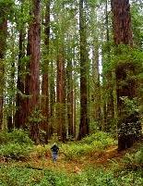
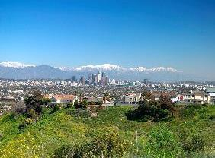
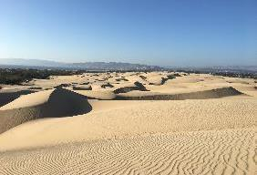
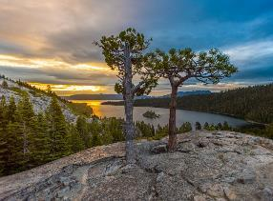
About California State Parks
Largest state park system in the nation
280 state parks throughout California
100’s of different classifications
Protecting precious resources
Notes:
Positions available in wide areas of study
Opportunities available for all experience levels and education levels
280 different locations throughout the state to choose from!
Our mission is to protect California’s natural, historical and cultural resources

Slide 6
Benefits
Compensation - State Service Credits
Retirement, medical, vision and dental benefits for self and family, paid holidays, paid sick leave, paid vacations, paid family leave, pay differentials, and more!
Culture of Inclusivity
Creating a diverse workforce that reflects of our state’s population
Flexible schedules
Potential 4/10 schedule, overtime and potential telework
Entry level to journey level and supervisory opportunities
State Parks Housing
Some locations offer housing
Notes:
The State of California offers many benefits that allow you to have the comfortable lifestyle and stability. From competitive salaries, excellent retirement, and coverage for your family. You also have the option to telework, earn pay differentials for high cost of living areas, bi-lingual abilities, and you can also earn overtime or holiday pay.
CSP’s goal is to ensure that our workforce is reflective of California’s diversity. This means access to parks and Parks Jobs.
For those that are mission centric in their job searching, our mission is to preserve California’s precious natural, historical and cultural resources.

Slide 7
Understanding the State Hiring Process
1. Create CalCareers Account
Your profile
Save documents
Save searches for exams or vacancies
2. Establish List Eligibility (full-time only)
Take the Exam for the job that interests you
3. Apply!
Discover current opportunities at www.LiveTheParksLife.com
Send your official state application form (STD 678)
Notes:
What can you do with your account?
Create and Save Documents
Save multiple application templates
Keep personal information current
Save potential job opportunities
Benefits of a CalCareers account:
Be contacted by employers
Stay up-to-date with new job opportunities
Submit multiple applications at once for both exams and job vacancies
Exams! State examinations are a way to ensure that fair and equal hiring practices are followed as well as gauge whether a candidate meets the minimum qualifications for a specific classification.
Each classification will have its very own exam associated with it.
Apply for the job – You are now list eligible. Please note, Hiring managers must select applicants from an eligibility. Its not like private sector where anyone can send in an app and get hired.

Slide 8
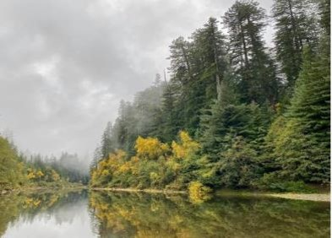
Step 1
Creating Your
CalCareers Account
Notes:
Humboldt Redwoods SP

Slide 9
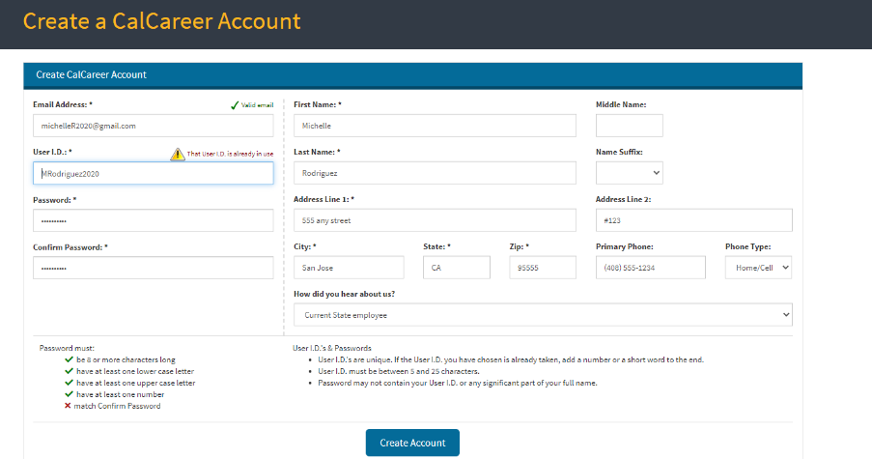
Notes:
No one has access to your CalCareers account – only you.
9 fields to complete, all about you
This is your contact information that hiring managers will use to connect with you.

Slide 10
Michelle Rodriguez
Michelle Rodriguez
Notes:
Your dashboard!
Why create the account first???
Create your application templates (you know you are using the right form, its easier than trying to type into it, create different templates, save $$ because you don’t have to make copies!)
When you sign up to take an exam you will be redirected to your account – saves time
All your documents stored in one place!
Email Messages are for you to receive contact letters from prospective employers!

Slide 11
Questions

Slide 12
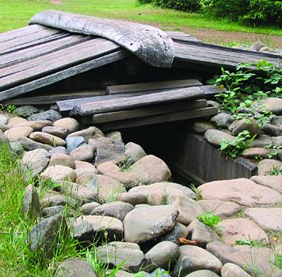
Step 2
Establishing List Eligibility
Taking the Exam
Notes:
Sue-meg SP (sweathouse)

Slide 13
Types of Exams
Online Continuous
Self Evaluation
Technical
Online Cyclical
Occurs during specific time frames
In person Technical
In Person Demonstration
LEAP – Limited Examination & Appointment Program
Notes:
There are several types of exams:
Online with technical questions given at certain time
Continuous/on-going online self assessments
In-person technical / demonstration
LEAP – demonstrating the work for persons with disabilities
For those that served in the military, there is the Veterans Preference Benefit. This program provides military benefits for veterans who seek employment with the state. Get CalHR certified as a veteran before you take an exam, and you can receive Rank 1 when you pass with a 70% or better.
Note: Important to apply for the exam when the opportunity is available. You want options!

Slide 14
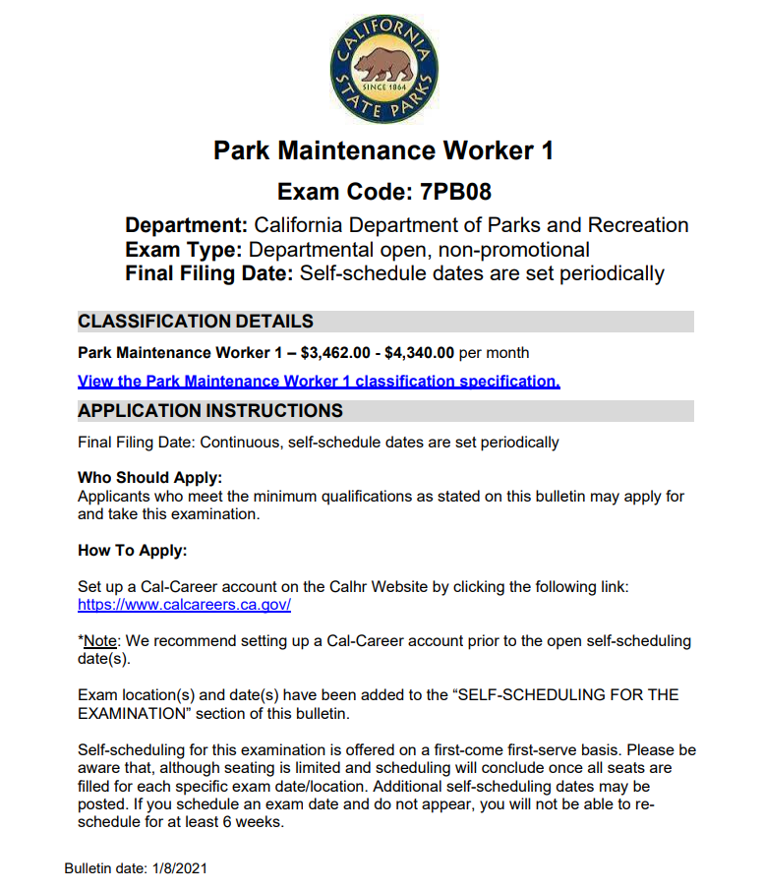
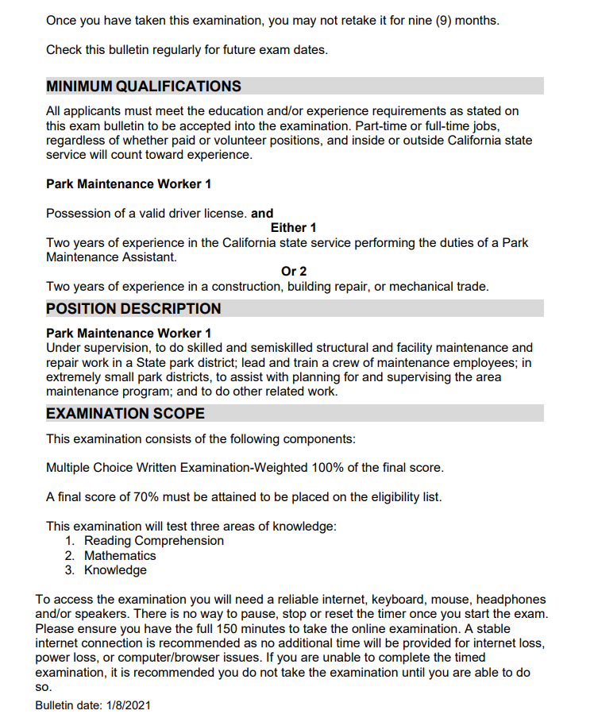
Official Exam Bulletin
Notes:
Things to look for:
Exam type & Final Filing Date: open-statewide, continuous
Classification Specification
Where/how to Apply
Minimum Requirements – eligible to take the exam

Slide 15
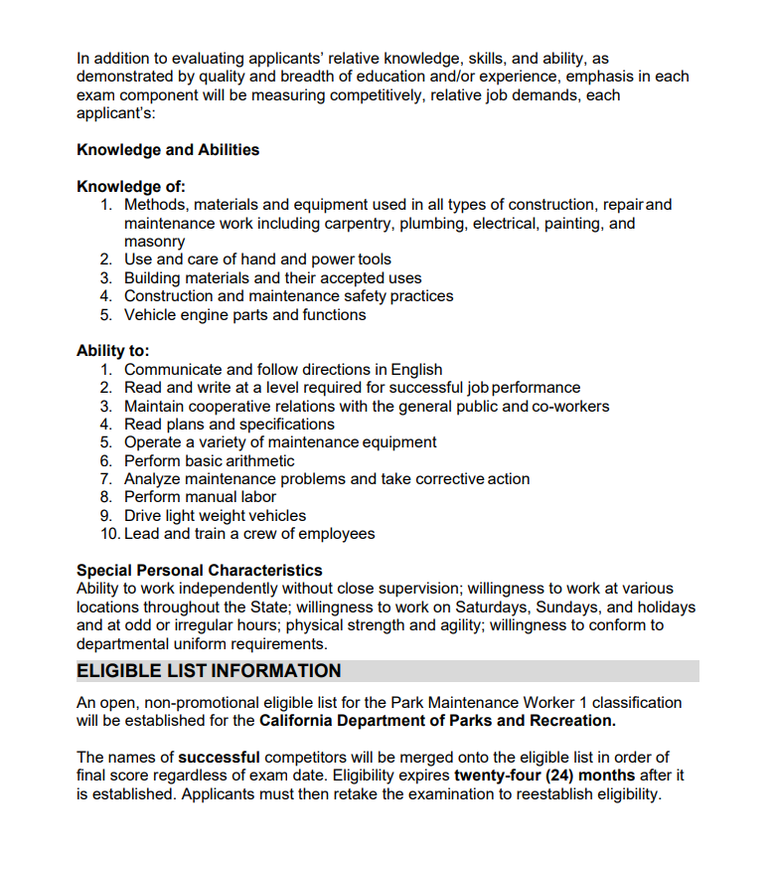
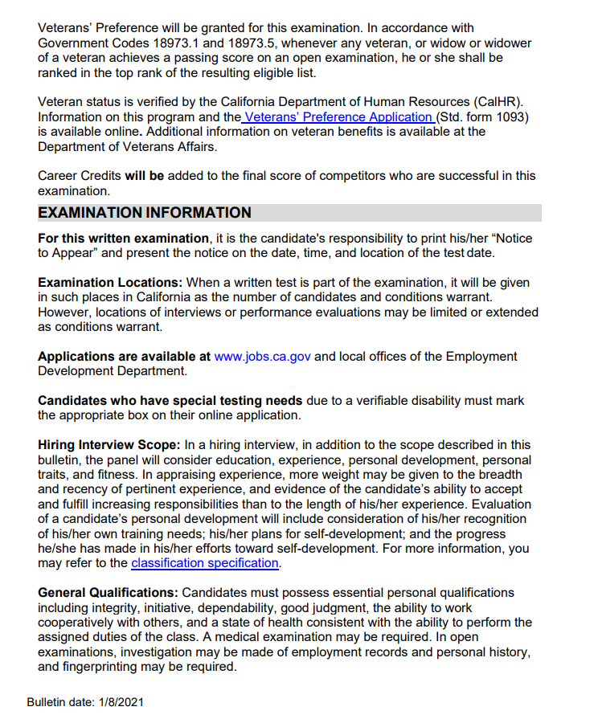
Official Exam Bulletin (continued)
Notes:
NOTE: have your LEAP certification or your Veterans status certification BEFORE you take the exam.

Slide 16
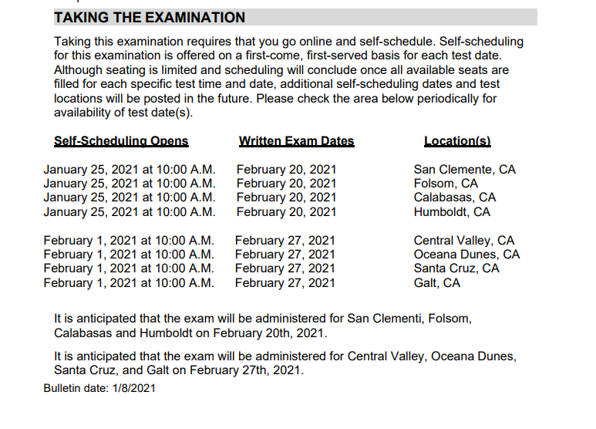
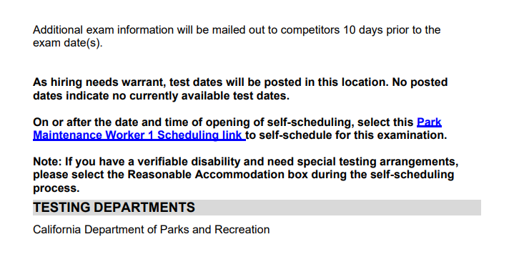
Official Exam Bulletin (continued)

Slide 17
Questions

Slide 18
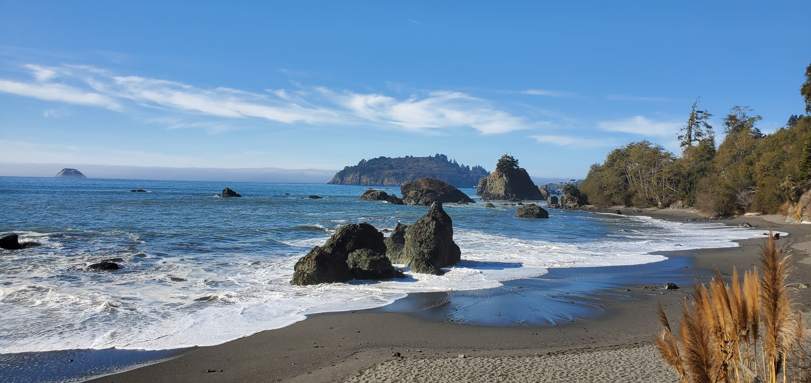
Step 3
Apply to the Job!
Notes:
Trinidad SB

Slide 19
Apply for the Job!
Explore opportunities and
discover the possibilities!
www.LiveTheParksLife.com
Notes:
Now you are eligible to apply and the hiring manager can consider you!
Visit www.LiveTheParksLife.com and explore the possibilities.

Slide 20
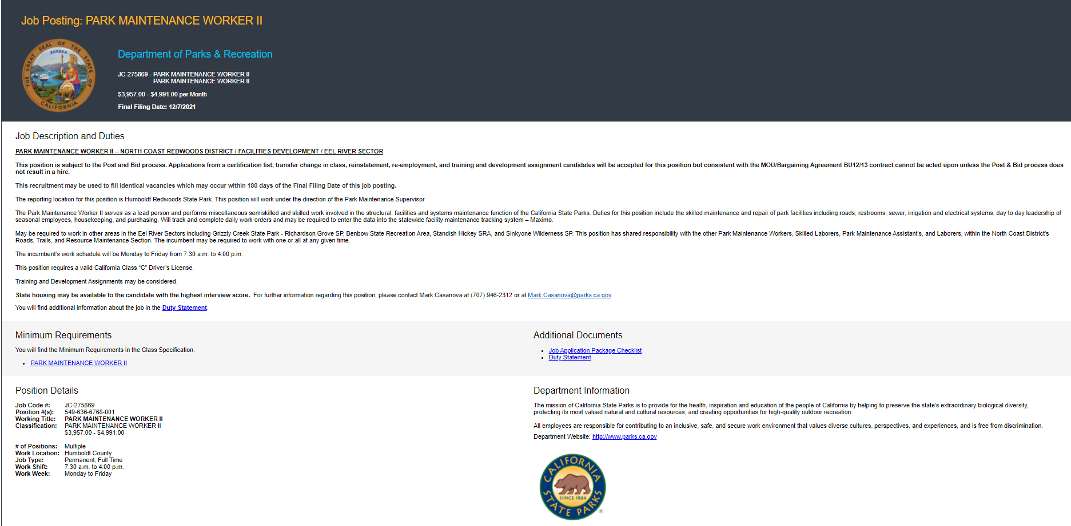
Reviewing Job Bulletin
Notes:
You found a job that interests you! You’ve clicked the link and now you’re staring at the bulletin.
Job Control and Classification Title (job title)
Salary details and the final filing date
After a brief description of the job you may have a special requirement.
Potential for housing information ☺
Contact info – usually this is the hiring manager
Duty statement – we’ll review shortly
Minimum requirement
Additional documents will provide you with a link to a checklist for your application package. Sometimes you may be required to include a SOQ, resume or special documents to confirm your eligibility.
Position Details – specifics about the opportunity
If asked: Post & Bid – those with this classification within the Department can apply and appointment is based on seniority. If no one bids on it, then hiring managers can review all other applications.

Slide 21
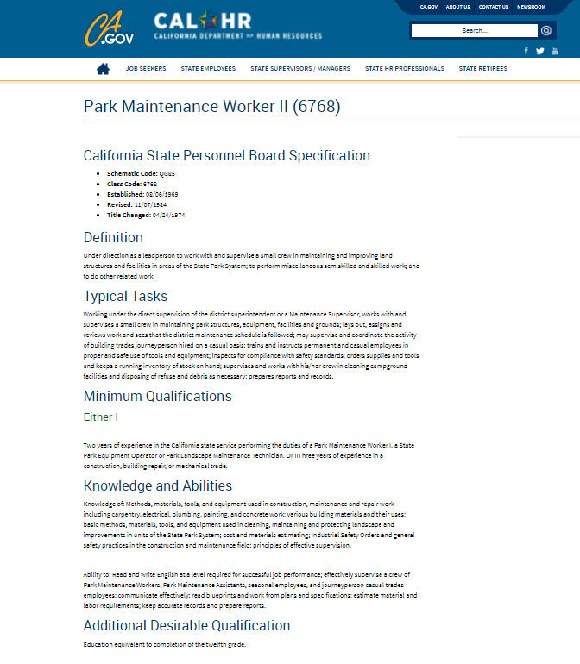
Classification Specification Minimum Qualifications
Define the classification
Typical Tasks
Minimum Qualification
Education
Patterns
Knowledge and Abilities
Special Characteristics/Additional Desirable Qualification
Notes:
All bulletins include a link to the classification specifications minimum qualifications that details the tasks as well skills & knowledge, and experience required to be considered for the job.
You want to demonstrate to all that you meet the minimum qualifications. You want to review the details and ensure you include the buzz words.
The good news about the MQs is that there are different patterns or pathways to allow you to demonstrate your experience fits.
First is usually a pathway for existing state workers
For non-state workers, alternatives exist, in this case 3 years of same level experience (see typical tasks)
Additionally, you’ll notice there is a pattern for a year-to-year experience in lieu of a degree. This means you need 7 years of experience at this level. 3 years experience described I the pattern and 4 years to cover the education requirement. If you have some college experience you can subtract that time from

Slide 22
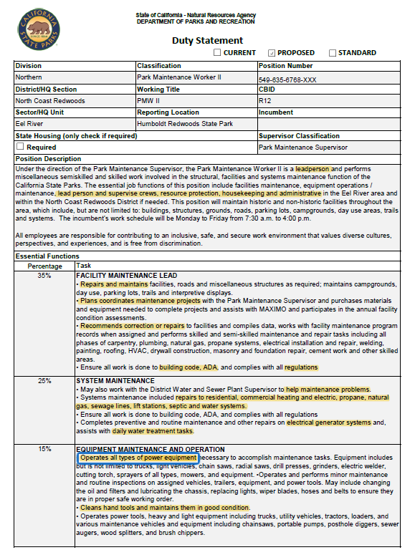
Duty Statement Review
Position description
Tasks specific to the job
Terms / Buzz Words
Notes:
All bulletins include a link to the classification specifications minimum qualifications that details the tasks as well skills & knowledge, and experience required to be considered for the job.
You want to demonstrate to all that you meet the minimum qualifications. You want to review the details and ensure you include the buzz words.
The good news about the MQs is that there are different patterns or pathways to allow you to demonstrate your experience fits.
First is usually a pathway for existing state workers
For non-state workers, alternatives exist, in this case 3 years of same level experience (see typical tasks)
Additionally, you’ll notice there is a pattern for a year-to-year experience in lieu of a degree. This means you need 7 years of experience at this level. 3 years experience described I the pattern and 4 years to cover the education requirement. If you have some college experience you can subtract that time from

Slide 23
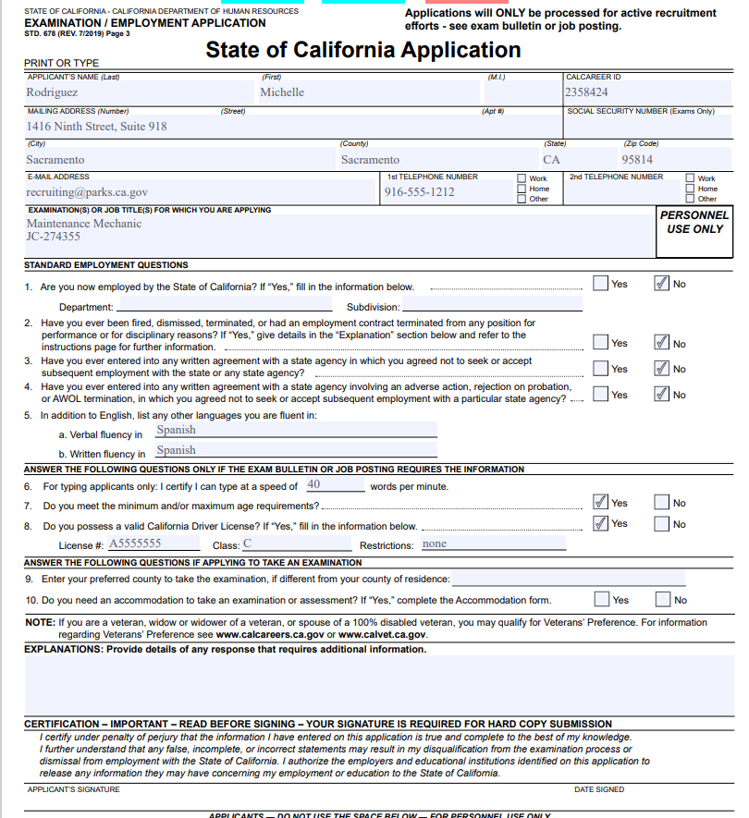
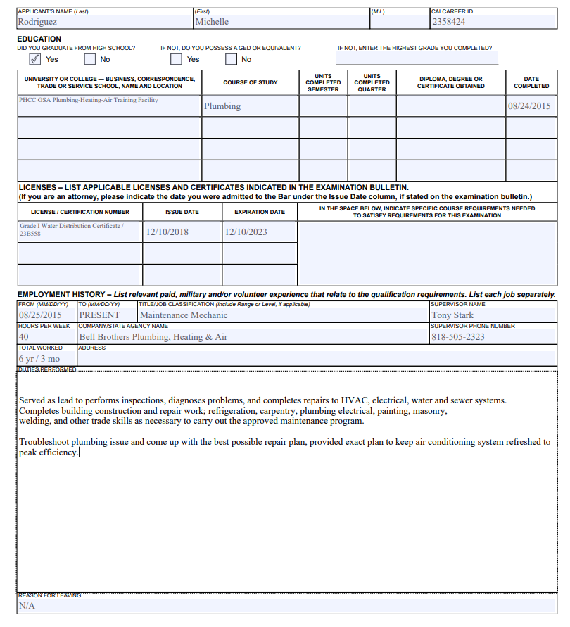
Completing the State Application Form (STD 678)
Park Maintenance Worker II
JC 275869
Michelle Rodriguez
12/07/21
Notes:
1. Your contact info - Note that the CalCareers ID is something that is generated by the system
2. Job control number and job classification or title – we get hundreds of applications on any given day for all our vacancies, we gotta know what they are applying to
3. Standard questions re any previous state work history
4. SPECIAL REQUIREMENTS
5. Sign
6. Date
7. Education requirement & any certifications
6. Employment history – be as detailed as possible (review the MQs & duty to ensure your work experience ties with the expectations –HINT use the same action words!!) The time spent at each job is a factor used to determine you meet the minimum qualifications
Two point vetting process!!!

Slide 24
Questions

Slide 25
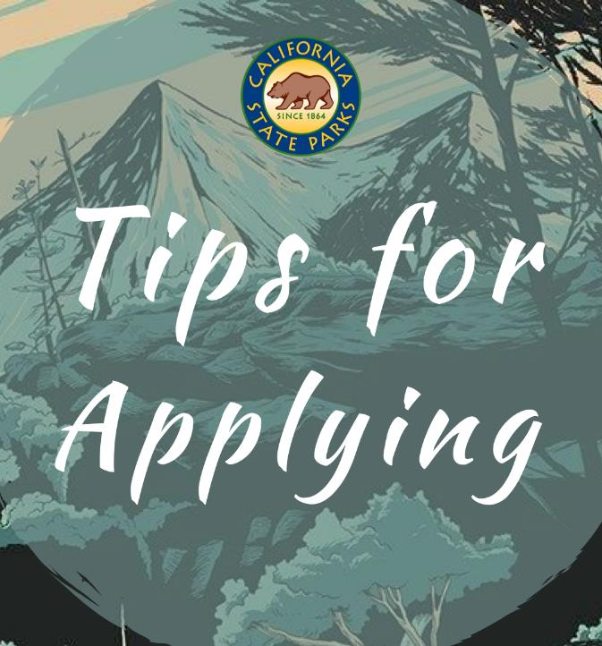
Thoroughly complete your application form
Study the classification specifications AND the duty statement
Use your resume as tool to promote yourself
Send your application by the Final Filing Date
Notes:
Review process: certification unit confirming you meet the minimum qualifications for the classification, then the hiring manager is confirming your experience makes you a good fit for the job.

Slide 26
It’s time!!

Slide 27
True or False?
The exam bulletin will indicate if the exam is in-person or online?
My list eligibility will vary based on the exam I am taking for the classification?
I can indicate “See Resume” on my application?

Slide 28
Types of Career Paths at California State Parks
Positions available in wide areas of study
100’s of different classifications
Opportunities available for all experience levels and education levels
280 different locations!
Notes:
Many different options for career paths and opportunities
Minimum qualifications will differ for each classification. In fact, whichever series you join, there are entry level to supervisory/managerial positions available!
Veteran’s Preference Benefits: https://www.calcareers.ca.gov/CalHRPublic/Landing/Jobs/VeteransInformation.aspx

Slide 29
IT and Other Administrative Jobs
IT Technician to IT Manager
Accountant Analyst Series
Budget Analyst Series
Administrative Assistant
Business Services
Executive Assistant / Secretary
Office Assistant – Office Technician
Park and Recreation Specialist Series
From Analyst to Manager and more!
Notes:
Type of work (IT)
Web design
Coding
Cyber Security / threat management
Troubleshooting
Product development – Parks Apps, camping reservation system, GIS
Type of Work (admin)
Developing reports
Analysis, developing policy/processes
Minimum Requirements
IT MQs: 15 semester units (or 22.5 quarter units) from an accredited college or university including at least 6 semester units (or 9 quarter units) of information technology
*College degree
2-5 years experience (Technician positions do not require a degree or previous experience)
The analyst series allows a bit of flexibility. When you see that a degree is required for some classification, you may notice that a year for year experience will be accepted in some cases.
Exams
General classifications, exams are available continuous and online. You could take an exam and apply for the job within the same day!

Slide 30
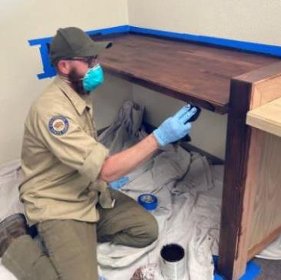
Facilities & Maintenance
Maintenance Mechanic
Groundskeeper
Landscape Technician
Plumber
Skilled Laborer / Carpenter / Electrician
State Park Equipment Operator
Heavy Equipment Mechanic
Electrician
Automobile Mechanic
Warehouse Worker
Park Maintenance Worker I
Notes:
Dave
Type of work: Restoration, custom building, maintenance and repair, defense from affects of climate change
Minimum Qualifications
CA driver license
18 years of age
HS diploma or equivalent
1-3 Years of experience
Some specific classification will also require certificates/licenses
Exams
most classifications include an exam specific to Parks and are scheduled for specific time frames throughout the year that come in cycles. The exams can range from online with technical questions to in-person demonstration.

Slide 31
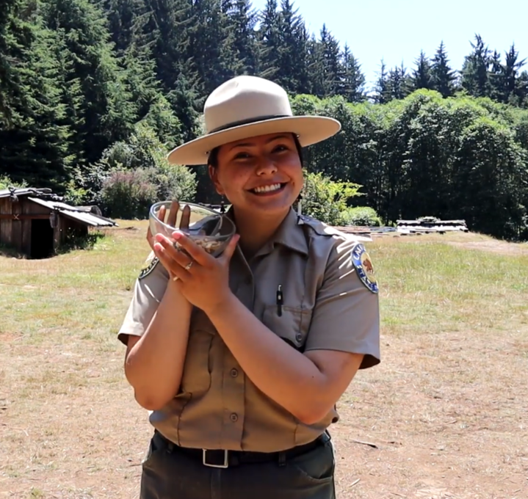
State Park Interpreter
Interpreters tell our story!
Interpret the natural, historical and cultural significance of our most precious resources.
Notes:
Type of work
Create educational programs for park visitors regarding the cultural, historical and natural significance of our resources
Minimum Requirements
One year of experience in research and
development of historical or natural
resource interpretive programs.
Graduation from college with degree in
interpretation, social sciences, natural
sciences, communications, or closely
related fields.
Exams
State Parks Specific – online with technical questions, currently the exam is scheduled for specific time frame, but our exams unit is working on pushing this out online continuous

Slide 32
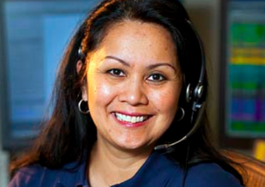
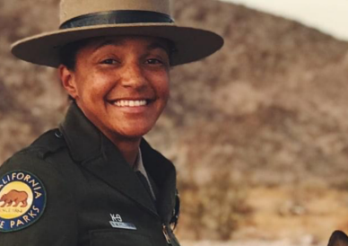
Law Enforcement & Emergency Services
Communication Operator
State Park Peace Officer
Dispatch field units to emergencies
Respond to calls for service & log incidents
Provide protection to the public and peace officers
Provide law enforcement and public safety
Protect natural and cultural resources
Provide education, interpretation and program management
Notes:
Type of work
Protecting the parks and visitors.
Communication Operators – emergency dispatchers
SPPO – rangers/lifeguards (k-9 units, beach, boat, OHV ) patrols, arrests, engagement with park visitors through educational interpretation
Minimum Requirements:
SPPO -
18 years of age
60 semester units from any accredited college/university/tech school (need at least 21 general ed credits)
Valid California DL
No previous experience needed – we train you on everything at our own Academy
Comms –
1 year of dispatch work or 2 years of managing a public phone (customer service line)
Highschool or equivalent
Exam
Parks specific, In-person, technical questions – POST written exam and must also pass a physical agility test and background for cadets prior to joining academy; Communbication operators have one year to complete the POST exam after being hired.

Slide 33
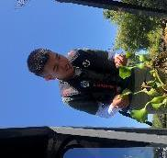
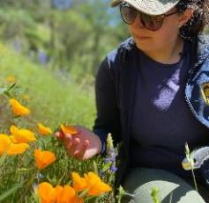
Environmental Scientist Series
Help protect the environment
Collect samples and data
Use this data to create policy or procedures to clean polluted areas, advise policymakers, and protect human health
Environmental studies can include studies on plants, wildlife, and nature as well as human health impacts
Notes:
Type of work
Fundamental in developing policy that helps protect public land from the effects of climate change, human health against invasive species of plants and animals, health of wildlife (plants and animals) against invasive species as well as humans
Minimum Requirements
A bachelors of science degree in a science related field:
Majors include biological, chemical, physical or environmental science, soil science, water science, hydrology, agronomy, natural resource science, environmental or public health, physical geography, or a closely related scientific degree
Note – registered seniors can apply
No previous experience – 2 years experience
Exams
Online continuous – technical questions. Take the exam and apply for the job in the same day!

Slide 34
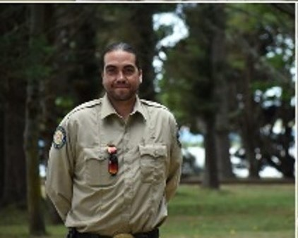
Part-time Opportunities
Start a California State Parks career as a Seasonal Aide!
Park Aide and Senior Park Aide
Maintenance Aides
Forestry Aides
Internships (specific parks only)
And many more!
Hands-on learning experience
Learn directly from full-time employees
No exam needed!
Build your resume
Notes:
There is a lot of flexibility with seasonal hires. No exam. You can apply directly and in some cases get hired on the spot. You can negotiate your work hours with the hiring managers. You can negotiate with the hiring manager to create your own duty statement to help you gain the type of experience you need for your chosen career path. While the department doesn’t have an official internship program, you can work with the hiring manager for a paid internship as a seasonal.
Seasonal staff typically make anywhere from $13 - $20 per hour.

Slide 35
Thank You!
Notes:
Xochi
Thank you for letting me be a part of your day.

Slide 36
Questions?
Ask us, we’re happy to help!
Recruiting@parks.ca.gov
Want updates?
Join the Parks Jobs Mailing List
Follow us @CASTATEPARKSJOBS
Explore
www.LiveTheParksLife.com
& discover the possibilities!
Notes:
Carly

